Slide 1
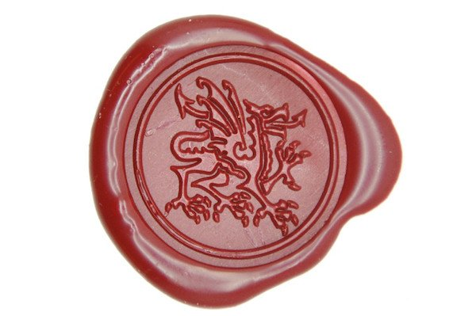
The Poetry Marathon
Certificate of Completion
This certifies that
Your Name Here
successfully completed the 2017 Poetry Marathon
and wrote 24 Poems in 24 Hours.
Caitlin Jans
Co-founder
Certificate issued by
The Poetry Marathon
August 2017

